Slide 1
Intro to Neural Networks:
Notes from Deep Learning with Python
Jan 25, 2018
Overview:
1) Data Representation: Tensors
2) Fundamental Concepts of Simple “Feed Forward” Neural Networks
3) Development Process of Neural Networks

Slide 2
Intro to Data Representation:
Reference: Deep Learning with Python
The fundamentals of how Neural Networks/Deep Learning work, is the process of feeding data into the black box, and after some training, being able to predict the right output(or target) , given an input sample.
It is then a natural consequence that how we structure that input data is EXTREMELY important to any deep learning process to even begin.

Slide 3
Data Representation: Terms
Tensor: a generalization of matrices to an arbitrary number of “dimensions” and “axes”.
ie) a single point, an array, a 3D vector, and a video can all be represented by tensors with different “rank” or axes with an arbitrary number of dimensions.
Rank: a tensor’s “rank” is determined by the number of axes or different types of axes a tensor can take on.
Axis Dimension: the total possible number of values stored on a specific axis.
Shape: the number of axes, and the total number of values stored on every axis determines a tensor’s shape. Shape is always described by a TUPLE

Slide 4
Tensors: examples
Scalar (0D tensor): a tensor which contains only one number is considered a scalar or 0th Rank tensor
Vector (1D tensor): an “array” of numbers with exactly one axis. Any number of dimensions along this axis is allowed.
ie) a 3D vector which can take on values (arbitrary range) in 3 dimensions would be considered a first rank (1D) tensor of shape=(3), since there is one axis, and 3 values are stored specific to that axis.

Slide 5
Tensors: examples
Matrices (2D tensors): a collection of vectors (or 1D tensors) would be considered a 2nd rank tensor. The number of values stored in each row is arbitrary to the rank of the tensor, but determine the “shape”.
ie) a matrix comprised of 8 vectors, where each vector (or row) can hold 4 values, would be considered a 2nd Rank tensor and would have
shape = 8 vectors which all hold 4 values
= (8,4)

Slide 6
Tensors: example
3D array = 3D Tensor: similarly to the growth in rank from 1D to 2D tensors, if you were to make a collection / row of 2D tensors, then you would result in having a 3D tensor.
ie) imagine having a 2D array / matrix which comprised of 8 rows of 10 elements of integers. Then if you had a row size 4 of these matrices, the resulting data structure could be considered a 3rd Rank or 3D tensor with shape (4, 8, 10)

Slide 7
Tensors of higher dimension
Tensors of higher dimension follow the exact same pattern, but are MUCH more complicated to describe in human language without using concrete examples.
With Deep Learning and Keras, unless we are analyzing video frames, we will be using tensors of rank 0 → 4
ie) a set of images would be a 4th rank tensor of shaped by: (number of sample images, height of sample images, width of sample images, channels of color used to determine the colors of each pixel)
Or more concretely, a set of 100 jpegs containing images size 100px (height )by 150 px (width) who are greyscale/black&white and the shades of a pixel can take on 10 different shades of grey, could be represented by a single 4D tensor of shape:
  (100 images, 100px height, 150 px width, 1 color channel (only shades of grey))
  Whereas a similar set of RBG images would be of shape:
  (100, 100, 150, 3 since each pixel takes on a range of Red, Blue and Green pigments)

Slide 8
Practical Notes:
In practice, it is very common to have the first axis a “batch axis” or “sample axis”.
The concept of batches refers to a technique in training where you do not process the entirety of a dataset at once before adjusting weights or doing a “learning” step. More on this later, but think of a “batch” as a chunk of samples we are using to train the neural network at any given step, and “batch size” as how many samples we are considering at once.

Slide 9
Practical Notes:
The second axis used, is typically called the “features” axis, and the dimensionality of this would equal the number of factors we are measure each sample/datapoint on.
ie) if we were to imagine a tensor representing pictures of dogs and cats, then our list of features could be: ear height, claw length, tail length, distance between eyes, nose size, etc.
And furthermore, a set of 100 cat and dog samples would be represented by a 2D tensor of shape: (100 samples, 5 different characteristics measured in centimeters for each sample)
A “Feature” is an extremely important concept in Machine Learning, and is basically what we are using to measure the differences between the different datapoints in our dataset.

Slide 10
Practical Notes:
Using sequence data, or data with a position in time/space, the 2nd axis is always the “timestep” axis. This can be somewhat difficult to visualize, but I will try to explain with an example:
ie) imagine we are using a tensor to describe 10 words, each of character length 12. Each character can be described by an integer 1-26, representing a letter of the English alphabet.
Our tensor would have the shape:
(10 different word samples, 12 characters or positions in each of the words, 1 feature encoded as an integer representing an English letter )

Slide 11
Tensor Operations: Functions
There are some functions that are used specifically for deep learning, and others which also apply to the field.
SoftMax: basically a weighted percentage based on the total size of a dataset:
ie) a set softmax([3,1,1]) = [0.6, 0.2, 0.2] since 3 makes up 60% of the total sum of all the entries.
This function is used to determine the likelihood of an possible classification/label decision being correct by squashing a bunch of outputs between 0 and1, where the outputs originally represented a likelihood factor of being the correct classification.

Slide 12
Tensor Operations: Functions
Rectified Linear Unit (ReLU): Useful in the actual process of learning in a neural network.
Really hard to explain its purpose without first introducing the perceptron and concept of a hidden layer.

Slide 13
Tensor Operations: Broadcasting
Firstly, “Element-wise” functions are functions which act on a single element or pair of elements at a time, and do not effect the output of other outputs being computed.
ie) Addition is a good example:
(4y + 3x) + (2y -2x) = 6y + x
Considered element-wise because the addition of the y variables will never effect the addition of the x variables.
Broadcasting is a way of altering a tensor’s shape to make it available to use element-wise functions on tensors of different shape.

Slide 14
Tensor Operations: Broadcasting
If there is no ambiguity in which tensor is of higher rank:
1) Axes are added to the smaller tensor to match the number of dimensions/axes in the larger tensor
2) smaller tensor’s values are repeated along the newly added axis/dimension to match the shape of the larger tensor.

Slide 15
IE) consider 2 tensors with shapes:
X=(32,10) and Y=(10)
Firstly, add an empty axis to Y to match the number of axes of X: Y = (1,10)
Secondly, repeat the values stored in that 10th dimensional vector, along the (newly created) first axis, a total of 32 times:
Y = (32,10)
or in Python:
Y[i , :] == Y for i in range(0,32)

Slide 16
Tensor Operations: Dot
The Dot product between 2 2nd rank tensors works identical to taking the dot product between 2 matrices.
There are ample resources on Google (and math 211) to explain dot products between 2 vectors, and the same knowledge applies directly to 2D tensors, and any Nth Rank tensor above that.

Slide 17
Tensor Operations: Reshaping
Often used to preprocess data/tensor before feeding it into a neural network.
Simply a way of reorganizing the columns and rows in a tensor to match a given format:
ie) x = [ [0,1], => x.reshape(6,1):x =[[0],[1],[2]]
[2,3], [3],[4],[5]]
[4,5] ]
Can be very useful for reorganizing the entirety of a group of samples, into smaller groups or batches of data/samples.

Slide 18
Feed-Forward Neural Networks
Sources: MIT 6.S191 Intro to Deep Learning: https://www.youtube.com/watch?v=IgSuFYamZas
Pictures from http://neuralnetworksanddeeplearning.com/chap1.html

Slide 19
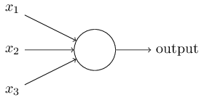
The Perceptron
Most basic “unit” of a Neural Network. We are looking at a simple Sigmoid Perceptron for Feed Forward Neural Networks.
How each perceptron works:
-Takes inputs from either another series of perceptrons, or a series of inputs from the user if it is in the first “layer” as well as a “bias” or threshold modifier.
-Each unit has a “Weight Matrix”, W, specific to the unit, which modifies the value of every input it is given. It modifies it by matrix multiplication, or a dot product.
-After modifying the inputs with the weight matrix, the weighted inputs are then summed together, and a non-linear “activation function” is then applied to the sum.
-The value found by the activation function is then the output of this hidden unit, which could feed into another perceptron, a whole layer of perceptrons, or just the final output of the Neural Network, depending on the position of this unit in the network.
A “hidden layer” is simply a group of perceptrons beside each other, working independently

Slide 20
For example:
Consider an arbitrary weight matrix for this hidden layer consisting of 1 unit(there is only one row since every row corresponds to a unit in the hidden layer/layer of perceptrons) : W = [1,2,3]
(Arbitrarily) assign the inputs x1=2,x2=4,x3= 3, and a bias/threshold = 5
Consider a simple activation function: g(x)=x/10
Then the output of this singe perceptron, given the weights, and activation function is:
g(W dot inputs + threshold) = output
g((1*1 + 2*4 + 3*3) + 5) = output
g(18+5) = output= 23/10 = 2.3

Slide 21
Perceptrons: Bias/Threshold
The bias/threshold of a specific perceptron (or hidden unit) acts as a modifier which acts as a baseline of the perceptron’s output.
Comparing the a perceptron with a lower vs higher bias/threshold, the perceptron with a lower bias, given the same inputs, would output a lower value than the perceptron with higher bias.

Slide 22
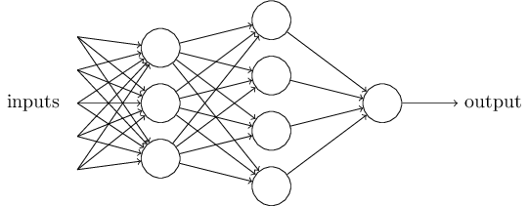
Multilayer Perceptrons
The diagram below represents a network of “Multi-layer Perceptrons”
It reaches a final output by taking the output of shallower/earlier perceptrons, and feeds them as the input to the later perceptrons.
This process/architecture is what defines a Neural Network, and a network with many intermediate layers is considered “DEEP”.
                → “Deep Learning”

Slide 23
Deep Neural Networks: Note
In all my examples, I have chosen to describe parameters/features which are human understandable.
This is not representative of how Deep Learning models actually learn, because in practice, humans really only know the first layer of inputs, which are fed directly into the Neural Network.
Any subsequent “parameter” or “feature” which is interpretted by the subsequent hidden/intermediate layer is determined by the network itself, by recognizing patterns in the parameters/features and the resulting correctness of a estimate/hypothesis.
This is a fundamental part of Deep Learning, since we are allowing the model to determine what it thinks is relevant when choosing the correct answer and avoids hardcoding in what we would think is relevant, given an initial input/feature list.
The hardcoding of features/parameters, called “Feature Engineering”, is typical of “Shallow” Neural Networks, and ends up being a bottleneck for more complex problems with thousands of parameters, where a Deep Learning Model would be able to determine those parameters by itself.

Slide 24
Perceptron: Activation Functions
In the previous example, we used a linear activation function just out of simplicity.
Non-linear activation functions are important because it allows multiple layers of perceptrons to transform the output of their summations, into non-linear outputs, allowing the network to recognize non-linear patterns in data input/input features.
→ If all our activation functions were linear, then from the characteristics of linearity, a linear combination of linear functions is also linear, ie: you could condense all the perceptrons into a single perceptron with a the combination of linear functions as the activation function. This would not allow the neural network to find non-linear patterns in the input, and would yield multilayer perceptrons utterly useless!!!
Activation functions are chosen in regards to the problem at hand:
Binary Classification Problems: Typically use “Sigmoid” function as the last ouput layer, which outputs a fraction which represents how likely a binary classification is to be correct
Multi-class classification Problems: Use “Softmax” activation on the last layer to determine, out of a number of classes (more than 2), what is the probability of each classification being true, and outputs the most likely answer.
More on activation function usage cases later…..

Slide 25
How do Deep Neural Networks actually “Learn”?
The weight matrix of a hidden layer in a Neural Network is not arbitrary.
Simply put, the process of learning is done by modifying the weight matrix for each hidden layer after each training sample, depending on how much “error” or “loss” was generated by using a specific set of weights. A training case’s “loss” can be modeled by its “Loss function”.
An example format of a Loss value for a specific training case/sample would look similar to :
loss = loss_function(f(x[i], weights),y[i])
where f(x[i], parameter values) represents the final guess/hypothesis during the training iteration, x[i] is the value for every input given to the network, weights represents the variable weights of each parameter considered for this specific sample/testing case, and y[i] represents the true/ predefined answer key’s value.

Slide 26
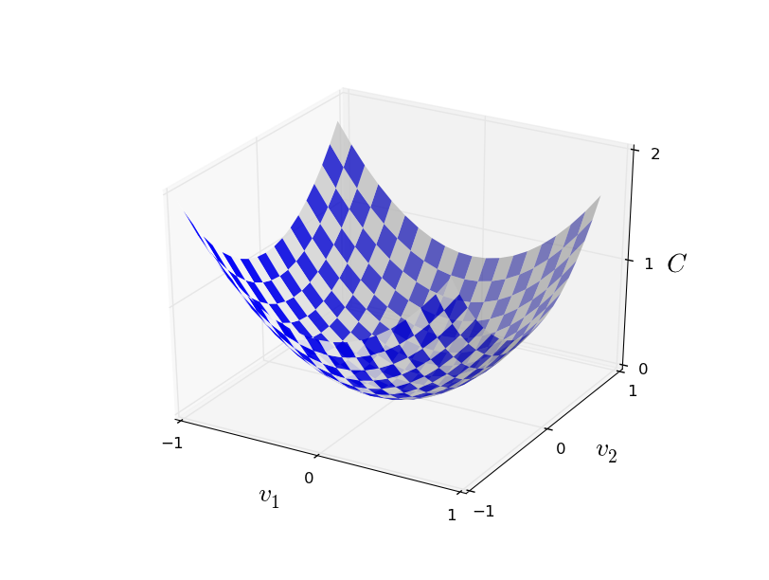
Loss Function
When the Neural Network outputs a result, in supervised learning, the Neural Network framework will compare its hypothesis, with a predefined answer key (called a LABEL), and will determine how right or how wrong the neural network’s hypothesis was.
The measure of error in a prediction can be modeled by a “Loss function”, which measures how much loss is produced given a set of values for the parameters(input.dot(weights)) with respect to each parameter.
What we end up being interested in, in regards to loss and loss functions, is the “total loss” in respect to a given weight matrix, and by imagining the total loss as a function of the weight values in the weights matrix, we are able to use calculus to find values for the parameters which result in a MINIMUM total loss.
This minimizing of total loss is fundamental in
how a Neural Network will learn to obtain
increasingly correct answers,
given enough sample/training cases.
Image pictured right can represent a loss function
dependent on 2 parameters/weights v1 and v2
resulting in “loss” measured on the z axis as C (cost):
The process of minimizing the loss with respect to the different
weights is a process called “Stochastic Gradient Descent”

Slide 27
Learning Example: Overview
For example: consider a neural network which determines if a set of characteristics describes an apple or a banana. The first training iteration (with a randomly generated weight set) could hypothesize that color = yellow and origin = tropical would result in a sample being an apple. But after comparing the hypothesis with the answer key, it realizes that the hypothesis was wrong, and it would then backtrack into its hidden layers, and alter the weights in a way that would recognize those inputs(features) to be characteristic of a banana, such that future observation of color = yellow and origin = tropical would result in a classification hypothesis being banana.
Similarly, if a hypothesis is correct (in our banana vs. apple problem), a Neural Network could use a similar Backtracking(Backpropogation) technique which would alter the weight matrix corresponding to strengthening the relationship between color = yellow, origin = tropical to a guess being banana.
A series of these “hypothesis-> compare with answer key-> update weight matrix accordingly” iterations is (simply put) what makes up one step of the learning process in a basic feed forward neural network.

Slide 28
Loss Functions: Notes
As you may have noticed, in Calculus, there exists the concept of a local minimum and an absolute minimum.
When calculating a loss function’s value, there exists a well investigated problem of getting “stuck” in local minimums (and their corresponding weight matrix values) which represent the “best values” for a weight matrix in respect to the parameter values surrounding this point, but when considering the whole graph of the loss function, there is a better set of weights which yield a minimum which is lower than the minimum found.
There are many solutions to this problem currently used in practice, one of them being the concept of “momentum” which mimics physical properties, and considers the “velocity” of the changing parameters in the previous “update weights” step in determining the current change in weights step.
The method you choose to use when moving along the loss function depends entirely on the “optimizer” you pass into the compilation step (in Keras at least)

Slide 29
Stochastic Gradient Descent
Pseudo-code/general algorithm:
-initialize weight matrix randomly
-For N epochs (how many times we will run through all the samples to update the weights):
  -for each training sample:
    -compute the gradient of the loss function, given the current values for the weights
    -update the weights/parameters in a direction which follows the steepest downward slope (in order to decrease the loss function).

Slide 30
Stochastic Gradient Descent
The process of updating the weights uses the concept of partial derivatives, learned in multivariable calculus. By considering the loss function, in respect to every individual weight for a parameter at a certain perceptron, we are able to determine what next value of this parameter would result in minimizing the loss value. By considering each parameter/weight pair independently, we can use a combination of these changes in weights to try and minimize the loss function’s value (loss/error).
The concept of “Backpropogation” comes into play when you are using neural networks with more than one hidden/intermediate layer of perceptrons. This is significan/relevant because the change in a different parameter of an earlier layer, will also effect the loss related to a parameter in a later layer.

Slide 31
Stochastic Gradient Descent: Minibatches
When computing the loss function’s gradient for every training set, we end up having to compute way too many derivatives for each individual sample/training case.
Also, the answer/loss value for single sample/test case may not accurately describe the problem as a whole, and basing the update rule on a single datapoint/sample may result in inaccurate changes in weights.
One way of mitigating the effect a statistical outlier datapoint has on the weight matrix, is a technique called MINIBATCHES:
Minibatches alters the SGD algorithm, by not considering a single testing point when calculating the update in weights, but considers a number of sample cases/datapoints, and then uses their average loss when determining the gradient w/ respect to the various parameters.
This process will make the model more efficient, since a series of gradients must only be calculated for a fraction of the entire datapoints/samples, and also leads to a more accurate change in weights.
Also: In newer computers, you utilize multiple processing units to calculate the gradient of different test cases within a minibatch in parallel, and sum them up to calculate the average gradient for a specific set of weights. This also makes computation much faster.

Slide 32
Neural Networks: overfitting
Neural Networks can become very powerful.
Since intermediate layers can make decisions based on previous decision results, the number of memorized classifications/answers can exponentially grow in magnitude, much like a game of 20 questions.
For this reason, on limited (finite) datasets, it is possible for a neural network to simply memorize a series of characteristics specific to the training dataset, to make super accurate decisions on training data (or data it has already seen/ made updates with respect to these samples), but when facing new datapoints, the model cannot accurately “generalize” its accuracy since it has simply memorized the training cases and did not learn general rules/parameters to solving the problem.
The phenomenon described here is called “Overfitting” a model to a specific training set, and is a challenge in all Deep Learning architectures/models.

Slide 33
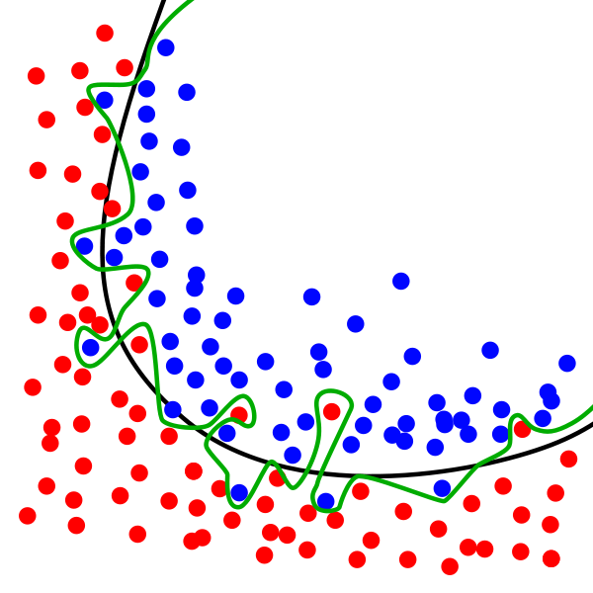
Overfitting: Visually
Imagine a naive neural network which determines if a test case is red or blue.
The process of Stochastic gradient descent ends up creating a model which, based on 2 given parameters, decides if a datapoint is red or blue, based on its location in a 2D cartesian plane.
The black line represents the (generalizably good) hyper plane learned by a model which did not overfit to the training set, and would then be able to classify (with pretty high accuracy) a new datapoint between red and blue, following the general trends of the sample/training cases.
The green line represents a hyperplane/set of decisions based on a model which DID exhibit overfitting, and found classification rules which are very specific to the training/sample dataset.

Slide 34
Mitigating Overfitting 1: Dropout
One way to stop the overfitting of a training dataset, is during training, set some of the activation functions for the hidden units in a layer, to 0, so that the next layer of perceptrons has to make a decision based on a fraction of the previous layer’s outputs. This is the DROPOUT of some hidden units, while the model is in training mode.
This prevents the whole network from basing its whole hypothesis on the output of any single unit, and makes the decision more based on a collective output from many of the perceptrons.
ie) in the banana vs apple question, applying dropout to a layer could force the network to not only consider color when classifying the fruit, since the final decision made was trained to interpret a combination of features/characteristics (color and origin) instead of looking at the answer to a specific classification question.
Once training is done, weight are not updated anymore, and the model is to be used on an unseen dataset, dropout DOES NOT occur, and every perceptron is used in making the decision. Since the model was forced to not make decisions based on a single output from a hidden layer/perceptron, the final decision is made by the collective answers from multiple hidden units.

Slide 35
Mitigating Overfitting 2: Early Stopping
Idea: Don’t give your Neural Network enough time/training iterations to recognize/memorize training-set-specific patterns. Only give it enough time to recognize the general patterns in your training data.
ie) when in training, keep a chart of how well your model is doing on the unseen datapoints. After the initial increase in accuracy occurs, and the “validation” datapoint accuracy starts to deteriorate, stop the training, since this indicates that the model is starting to memorize the specific characteristics, as opposed to following generalizable trends.

Slide 36
Mitigating Overfitting 3: Weight Regularization
Observation: Large weights in a layer typically mean that the model is basing its decisions on the output of a single perceptron, and not a collective decision. ie) if a weight from one perceptron is 10 and another is 1, then the first perceptron will have (with a naive, non-linear activation function) ~10x more influence in determining the outcome at this hidden unit.
Idea: In order to deprioritize the output of any given perceptron, we add another term in the Loss function which takes into account the squared magnitude of each weight, causing the SGD to travel in a direction which not only minimizes loss w/ respect to the weights of specific parameters, but also with respect to keeping the weights small, and penalizing a weight choice where few weights have significantly more influence than other weights.

Slide 37
Development Process of Neural Networks
Sources: Deep Learning with Python- Francois Challet

Slide 38
Intro
Many architectural decisions must be made when determining how to build a Neural Network
To understand the development process of Neural Networks, we must first understand the training, validation and testing processes.

Slide 39
Training dataset: this dataset is typically the largest of the 3 datasets.
Training Process: using the general Stochastic Gradient Descent algorithm, the training dataset is used to make a hypothesis, then adjust the weights in each weight matrix corresponding to minimizing the error/loss at the final decision.
validation Set: once all the training data has been considered when adjusting the Neural Net’s weights, a final “Validation” round is performed, where the network does not adjust its weights, but it simply tries to formulate a correct hypotheses to each datapoint in the validation set. The accuracy (or methods of evaluating error/loss) of a model is then measured by comparing the hypotheses to each datapoint’s label, with the predefined answer key for every point.
The Training→Validation process is repeated a specified number of times (what is called the number of “epochs”).
Typically, you would graph the measure of average accuracy(or other metrics of evaluating the correctness) of the model on the training set and the measure of accuracy of the validation set on a graph: error vs. epoch, or accuracy vs. epoch.
Once you find the point where testing set accuracy keeps approaching 100%, but the validation accuracy starts declining, you have found where the model should be stopped, because after that point, the weights are changing to memorize the dataset, or begin overfitting, and the validation accuracy starts declining since the weights being changed in the training cycle are not favoring generalizable (outside of the training dataset) patterns.
→ the stopping of the training process at this point is EARLY STOPPING

Slide 40
Testing Set: Finally, once the model’s hyperparameters(number of layers, number of units per layer, activation functions, dropout percentages, etc..) have been fine tuned to try and maximize validation accuracy, it is important to have a reserved set of datapoints, which have never been encountered (not even in validation) to test the final model on.
You cannot use the final testing dataset in the training process of the model, since even though the network doesn’t fine tune the weights w/ respect the that dataset, the human decisions made about the hyperparameters ends up “leaking” information about the validation set when making those decisions.
ie) adjusting the number of perceptron units to maximize the validation accuracy during the training of the model, will cause the model to overfit (to a lesser degree) to the validation set.
By only using the final testing set a few times when the model is just about finished, you can use the its testing accuracy to make assumptions about the accuracy of the model in real world situations, where you have a bunch of datapoints, but not the annotations(or answer keys) associated (the point of building the network is to classify unclassified datapoints with high accuracy).

Slide 41
Dataset Partitioninng
It is a constant challenge in deep learning to find a large enough dataset, which would not cause overfitting to a small set of points, and would allow the model to learn features/decisions that generalize to the real world situations.
There are number of ways you can divide your entire dataset into subsets for training, validation and testing. 3 discussed in Deep Learning with Python are:
-Simple Holdout- simple paritioning of points into 3 sets
-K-fold Validation- partition set into K paritions, and separately train K models where each model uses a different partition as the validation set, and the remainder for training. To measure loss, you would take the average loss computed between all the different models, in order to try and get a loss value which generally represents the whole dataset, and not specific to a certain choice of what you used as validation data.
-k-fold validation with Shuffling- a spin off of k-fold validation, where you perform k-fold validation a number of times, every time shuffling the entire dataset as to get partitions composed of randomly chosen samples. This ends up being the most accurate way to partition your datasets, but will be the least computationally efficient.
If you want to learn more specifics/examples, look in the PDF…..

Slide 42
Universal Workflow of Machine Learning/Neural Networks
1) Defining the Problem
2) Choosing a Measure of Success
3) Deciding an Evaluation protocol
4)Preparing Data
5) Developing a model that works better than statistically random decision making
6) Scaling up -developing a model that overfits
7)Regularizing the model and fine-tuning the hyperparamers

Slide 43
1.Defining the Problem
Find input data
Determine what we are trying to predict
What deep learning problem are we facing?
  Multiclass classification
  Linear regression
  Binary classification
  Etc.
Keep in mind that machine learning uses previous examples to formulate future predictions. Ie: the future will act like the past.
Problems which will change over time, such as average temperature, will likely not be accurate since a prediction would be based on a yearly average. Such a problem would benefit from considering the average temperature PER MONTH as opposed to average yearly temperature.

Slide 44
2) Choosing a measure of Success
In keras, the “metric”, or generally, your high level goal. Ie: trying to maximize the profits of your business based on historical records, or maximize the accuracy of classifying a datapoint into a category.
How you define/choose your loss function.
Ie: balanced binary classification: accuracy is typically a good choice
unbalanced classification (classes who are not equally likely to occur): precision and recall are typical
ranking or multiclass classification: mean average precision
linear regression: (ie prediction housing prices) mean average error, or average distance from the true value.

Slide 45
3. Deciding an evaluation Protocol
How to measure progress
Simple hold out- lots of data
K-fold validation- too few samples to reliably hold out data
Iterated k fold validation with shuffling- highly accurate model evaluations with a low number of samples. Needs LOTS of CPU/GPU power

Slide 46
4) Preparing Data
Format data into tensors
Scale the data in the tensors from 0 ->1
ie: NORMALIZE the datapoints
This must be done to maximize the effectiveness of a Neural network, because using different scales for different features in the input will make your neural network not only have to find the patterns and correlations between input values and the correct mapping/prediciton, but the neural network will then have to learn the max and min values of the datapoints, and then learn the mappings.s
Data preparation can involve some sorts of FEATURE ENGINEERING, where you decide what to feed the network’s first layer as features/important characteristics which will determine the future decisions made. This part of data preparation can MAKE OR BREAK a neural Network, and can cause unsolvable problems to be solved very easily.
Ie: feeding a neural network 10,000 100x100 px images of analog clocks to determine current time vs feeding a neural network 10,000 polar coordinates of the hour hand on a clock to determine the current time. The previous approach would require a complex convolutional network to analyze the time, and the second approach would barely need deep learning to come up with incredibly accurate results.

Slide 47
5. Developing a Model that works better than a baseline
3 Key decisions must be made to achieve “Statistical Power”, or a noticeable increase in accuracy in comparison to randomly chosen answers.
Last layer activation funciton: what the output of the final layer is going to give you. Will it be the most probably classification choice in a multiclass classificiation problem? Will it be the most probably value of a house given certain neighborhood/location characteristics?
Loss Function: should match the type of problem being solved. Pretty good rules of thumb on this choice in the book.
Optimization Configuration: how to travel along the gradient, how big of steps to take along the gradient when you find an error in decision making, etc..

Slide 48
6. Scaling up and developing an overfitting model
Once a model has statistical power, keep adding layers, units per layer, train for more epochs, etc. until you can recognize a point where the model is memorizing the training set and achieving really high accuracy.
By doing this, you are able to know that you have given the model the right type of inputs, and it is recognizing patterns in the data which accurately map to the correct responses.
This is necessary in the balancing of:
Overfitting vs. Underfitting.
Or
Optimization vs. Generalizability.

Slide 49
7. Regularizing the model and fine tuning the Hyperparameters
Once you have developed a model that overfits, you can be certain that it is recognizing some sort of relevant pattern in the input data.
The next step is to scale back the optimization, in order to maintain accuracy on the validation set, but also force the model into learning general patterns in the input data, not only training-dataset-specific patterns.
Ie: slowly reduce the number of layers in the neural network. Slowly reduce the number of hidden units per layer. Add a dropout layer. Add regularization functions. Try different validation approaches.
Constant monitoring of training/validation accuracy in order to find that “sweet spot”

Slide 50
8) Final Testing
Once all the previous steps are performed, the model you build should be optimized and any further increase in accuracy could only come from:
increasing training set size, gathering more data
altering the form of input you are giving to the model
changing the entire approach
The testing set can then be used to determine if the model actually works.
If the model performs significantly worse on the testing set than the last validation iteration, this could be a result of a few problems in your model:
  Validation procedure was not reliable, giving you the illusion of higher accuracy.
  We were overfitting the model to the validation dataset, meaning that the hyperparameters being fine-tuned only really helped accuracy on the validation set, and did not cause the model to become more generalizable.

